Slide 1
Festivals and community engagement
Nordic-Baltic Festival Platform Conference
22 November 2017
PANEL 2

Slide 2
summary
The festival as a performative act, festival as ritual.
What is a community?
What are the ways of community building? (local communities/temporary communities)
How volunteerism can encourage community development?
Who owns the festival and to what extent? (artistically, logistically, financially)
Festivals and communities have mutual influence on each other, but who sets the boundaries, values, practices in these processes?
What is the impact of the festivals on the artists and the local communities?
What has Richard Florida just said?

Slide 3
notions
FESTIVAL
festivity, feast, celebration, communion, gathering, common past-time in a certain space, usually repeating (yearly, biannually, etc.),
artistic, cultural, social features,
performative and ritualistic: a series of actions, at a certain time and space (hic and nunc).
COMMUNITY
complex, and many models and definitions: sociological and anthropological approaches,
common features of the definitions: a number of people at a certain geographical location, doing or not doing something together
festivals growing out of some community traditions (usually folk traditions)
communities growing out of a festival tradition: a. long-term or b. temporary communities

Slide 4
long-term community building
volunteerism
each year starts from spring
visiting the locations
engaging the local communities/volunteers into dialogue about the festival, the artistic possibilities and choices, about the best locations, about the possible audiences

Slide 5
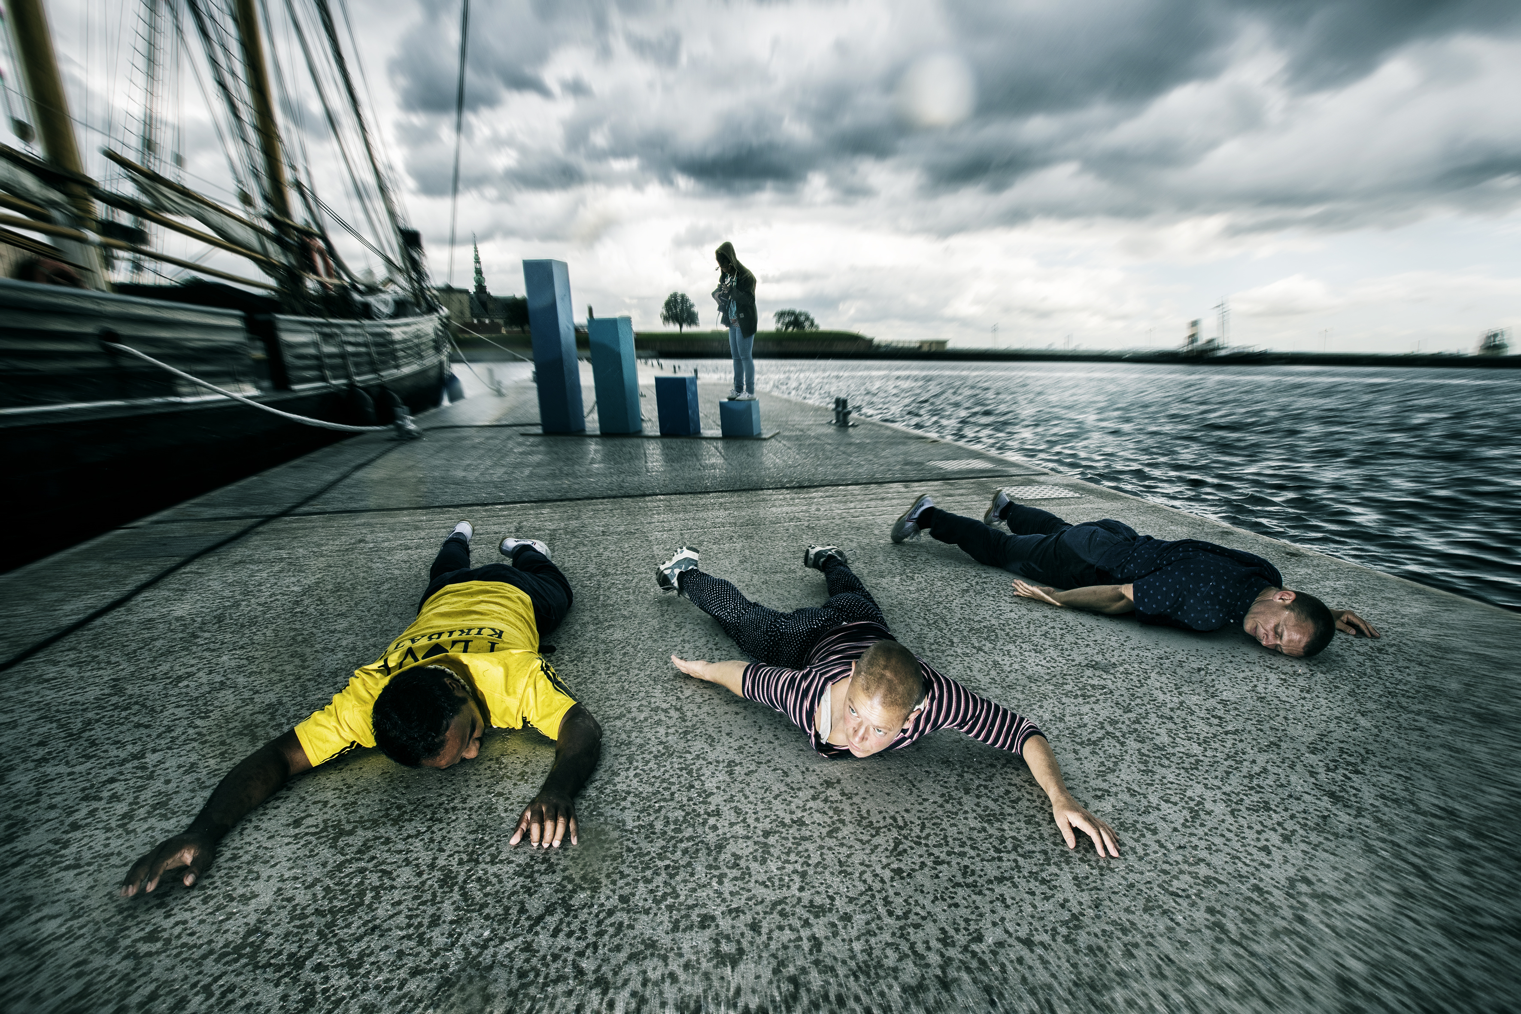
short term community building (temporary communities)
temporary community: one event brings together a number of people, for a definite time at a definite place.
any festival has its temporary communities (those attending one or a number of events, or the whole festival: once or repeatedly)
there are events that emphasize temporary communities: e.g. performative walks or: insertion, intervention, interaction.

Slide 6
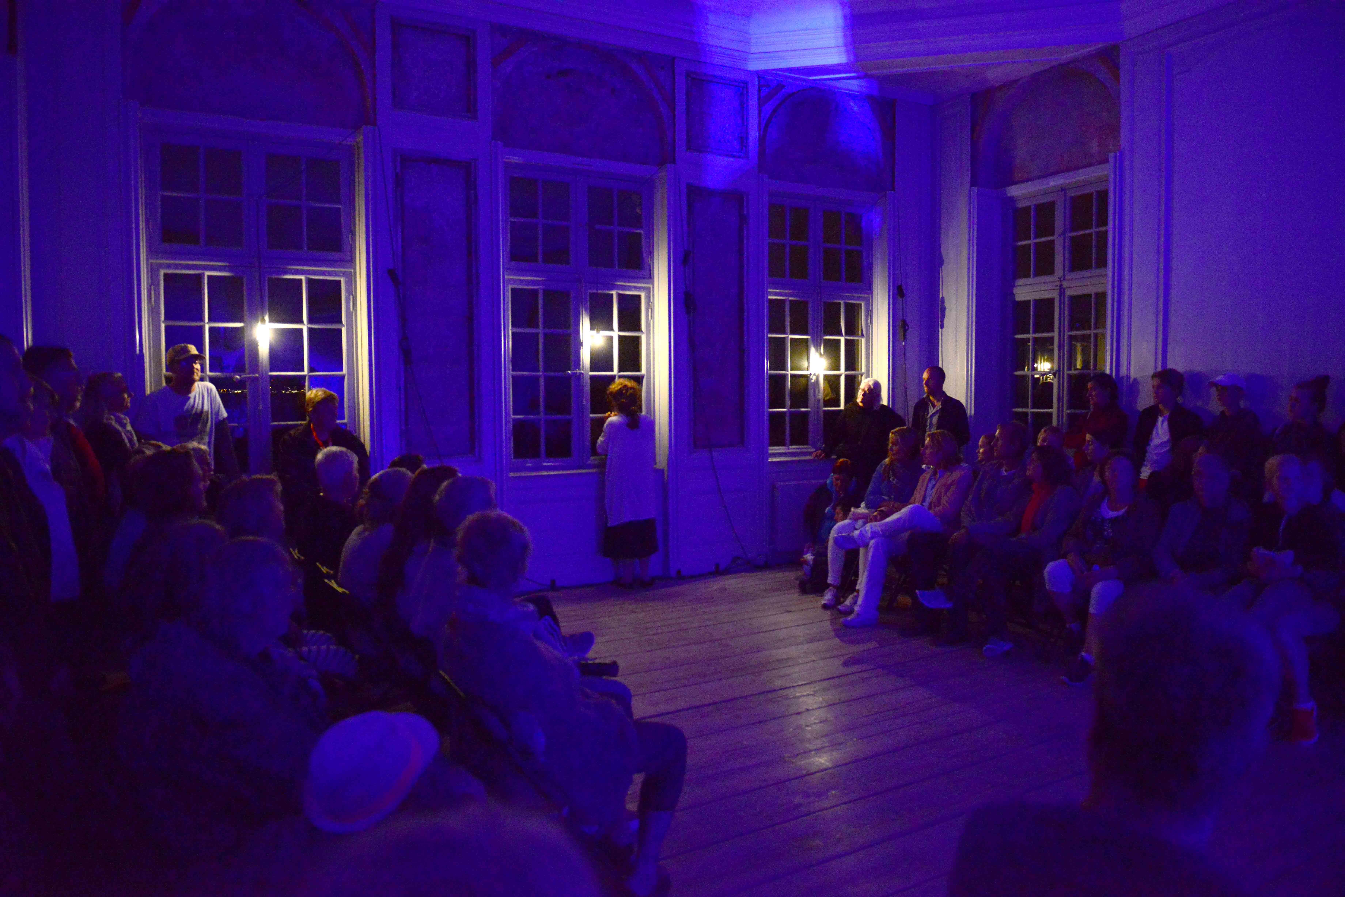
festivals and communities: who owns the festivals and where are the boundaries?
artistic, logistic and financial ownership
who sets the boundaries, the values and the practices?
reciprocity: how to find the good balance?
e.g. Power of Diversity (international network, EU-project), participants (i.e. actors) were selected from each location.

Slide 7
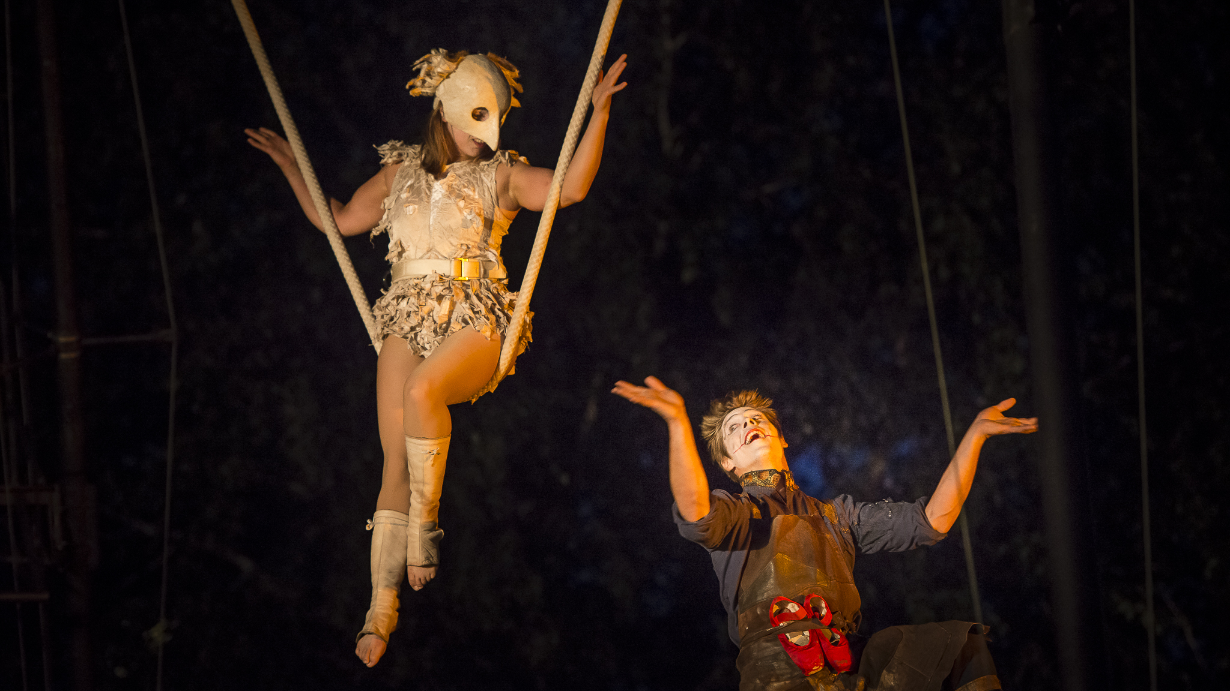
Richard Florida
The Rise of the Creative Class. And How It's Transforming Work, Leisure and Everyday Life, 2002. Basic Books.
- creative class (mixture of ’bohemians’: technology workers, artists, LGBTQ communities, activists, etc.) attracts economic growth and raise of the middle class, so urban space has to be shaped accordingly, creative class has to act accordingly
The New Urban Crisis: How Our Cities Are Increasing Inequality, Deepening Segregation, and Failing the Middle Class—and What We Can Do About It, 2017. Basic Books.
- economic crisis (2008) + urbanisation, gentrification of bohemian neighbourhood led close to disappearance of middle class (the rich became richer, the poor poorer)

Slide 8
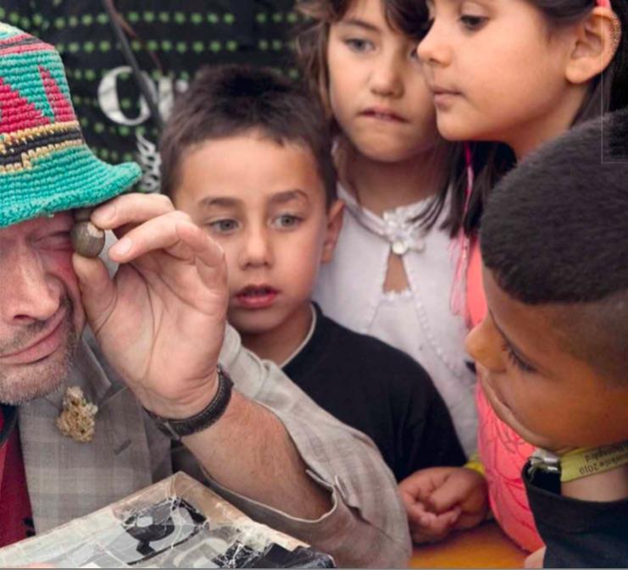
some further examples of Passage
Kumulus (FR) 2010 – workshops in Helsingør and Kokkedal
participants: Danmark, Sweden, Uganda, Iraq, Morocco, USA, Lebanon, Somalia, Brasil
Hjemstavn project (2010-2012)
housing areas

Slide 9
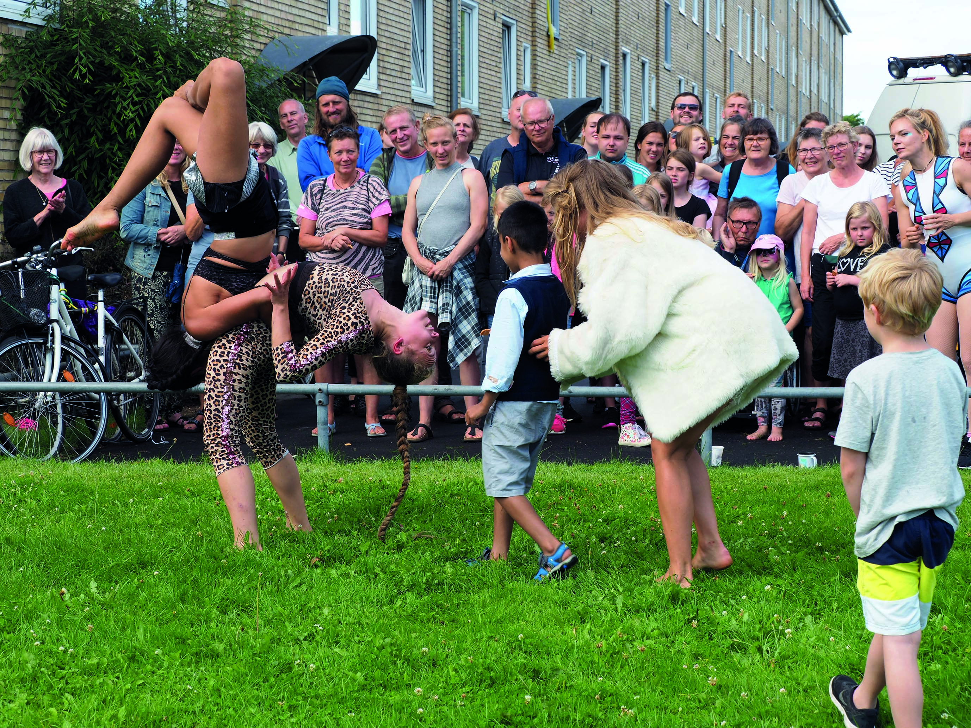
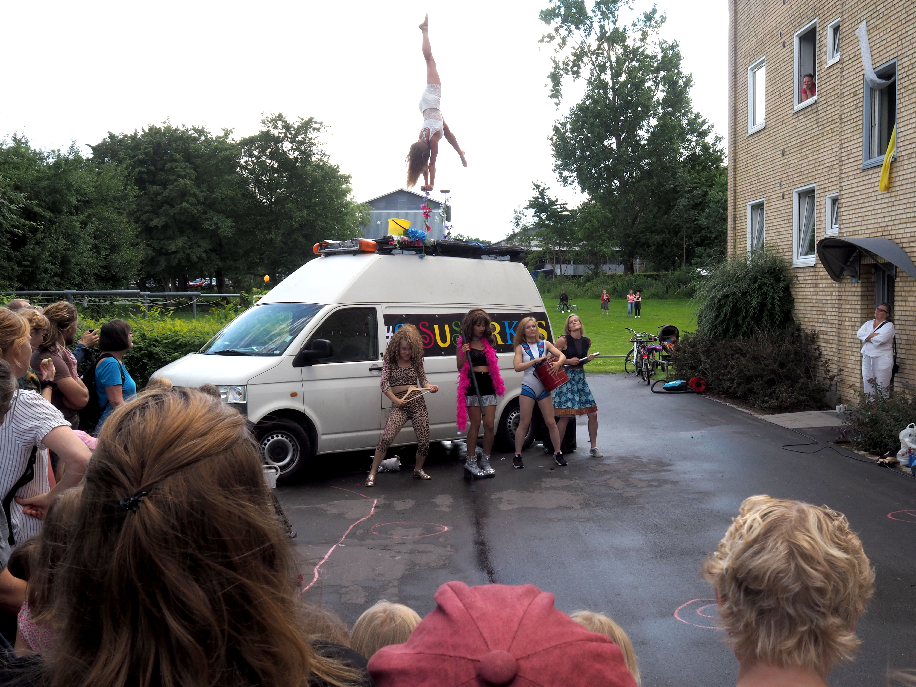
some further examples of Passage
housing areas (started 10 years ago): urban space, public space that has not been used as public space – the strategy of the municipality’s strategy
(single parents, elderly alone + villas)
Sissus (FI) – Uncomfortable Places (2017) in North-West Helsingør

Slide 10
THANK YOU!
Rita Sebestyén, PhD – PASSAGE FESTIVAL, Helsingør-Helsingborg
Main publications in the topic:
A Hailing Community. A socio-political meditation on Christian Falsnæs’ Front (Border Roads, 2017)
Before it is too late. Social sensitivity, synchronicity and participatory aspects of Scandinavian culture, with a special outlook on the oeuvre of Thierry Geoffroy, Colonel (Border Roads, 2016)
Otherness and the Performing Arts (Aarhus University, 2016)
Spaces Redrawn by Theatre. Passage Festival: dialogue of urban and theatrical spaces (Symbolon, 2013)

